Slide 1
Medium of the Arts

Slide 2
Unless an artist translate his experience into a form that can be perceived, It cannot be shared by other people. Art has to exist in some medium to be recognized as such.
Medium in art refers to the materials that an artist uses to communicate his ideas, feelings and his thoughts.
Classification of arts according to medium
VISUAL ARTS
There are arts that we perceive with our eyes; mediums that can be seen and occupies space.

Slide 3
Classified as:
a.) Graphic arts or two – dimensional – drawing, painting, graphic processes, surface printing, commercial arts, mechanical processes and photography.
b.) Plastic arts or three – dimensional – sculpture, architecture, landscaping, interior design, city planning, crafts, industrial design, dress and costume design and theater design.
AUDITORY OR TIME – ARTS
These are medium that can be heard and which are expressed in time. These are music and literature.

Slide 4
COMBINED ARTS
These are medium that can be heard both seen and heard and which exist in both time and space. Theses include dance, drama, the opera and the movies. Each artwork is apprehended as “happening.”
The Artist and His Medium
When an artist proceeds to give shape to his vision, his first thoughts are on what medium to employ.
An artist’s choice is usually influenced by such practical considerations as the availability of the material, the use to which the art object will be put, the idea that he wants to communicate and the nature and special characteristics of the medium it self.

Slide 5
The nature of each medium determines the way it can be worked and turned into a work of art. It’s nature also determines what can be expressed through it. Only subjects that are frozen in one moment of time can be shown by the mediums of the space arts.
Each medium has its own rang of characteristics which determine the physical appearance of the product. It also has inherent limitations as well as potentials. And it is a wise artist who accepts the limitation and at the same time exploits them. For each medium has its own way of behaving. Although it responds to the artist’s way of handling it, it nevertheless imposes its will on him, daring him to explore its various possibilities.

Slide 6
The Artist and His Technique
A good artist makes his medium work for him to produce effects he cannot possibly attain by any other means. An artist’s knowledge of his medium and his skill in making it achieve what he wants it to, make up what is called technique.
Obviously, artist differ from each other in technique even if they work with the same medium. Each artist, working with the same medium, may employ a different technique at another time for another purpose. Technique is adapted as the need arises.

Slide 7
Medium of the Visual Arts
PAINTING
Painting is the art of creating meaningful effects on a flat surface. It is the process of applying pigment on a smooth surface – paper, cloth, canvass, wood or plaster.
Pigment is the part of the paint which supplies the color. It is a fine powder ground from some clay, stone or mineral, extracted from vegetable matter or produced by a chemical process.
Medium of Painting
Watercolor
In watercolor, the pigments are mixed with water and applied to fine white paper.

Slide 8
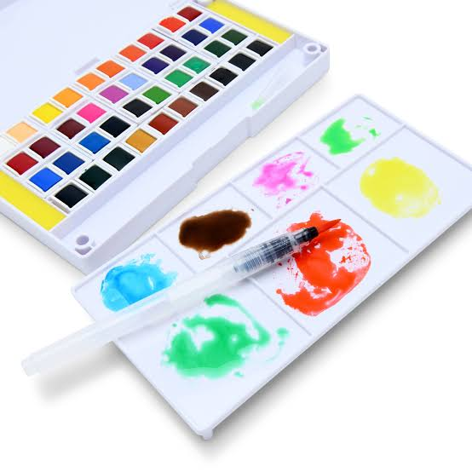
Water color

Slide 9
Gouache – paint in which the pigment has been mixed with a chalk like material which gives it an opaque effect.
Advantages
Watercolor is light and portable, best for horizontal or vertical scrolls.
Spontaneously is its very essence
Disadvantages
Watercolor painting has to be done in one setting because it dries quickly.
Oil
Discovered by a Flemish painter Jan Van Eyck in 15th century.
Can be used with brush, airbrush, palette knife, bare-hands.

Slide 10
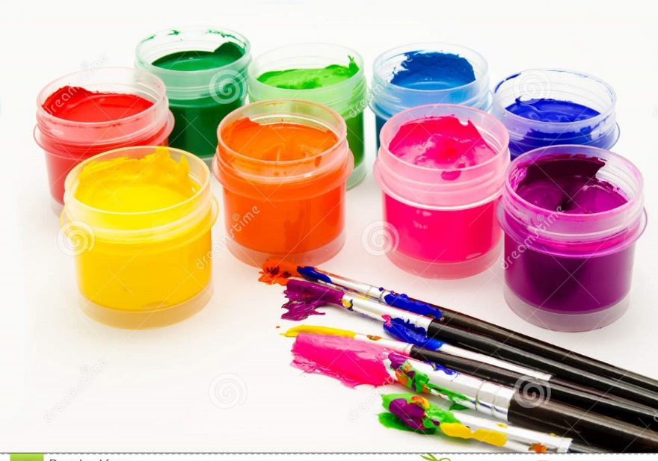
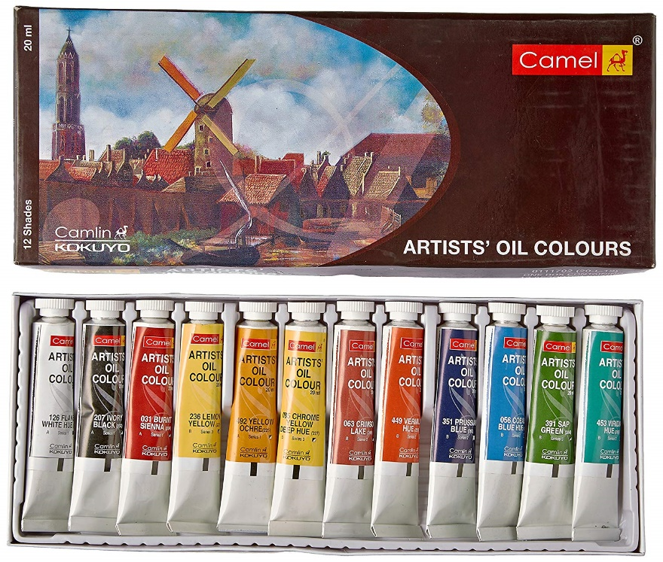
Gouache
Oil Paint

Slide 11
Pointillism – is painting in a small dot strokes of opaque paint close together.
The painter can apply paint in thin glazes of smooth subtle strokes or thick impasto to produce rough surface.
Advantages
Oil paint is the heaviest of all the painting media.
Very flexible medium; slow to dry and the painting can be changed and worked over a long period of time.
Disadvantages
has a tendency to rise to the surface and from a painting.
Oil makes colors full and yellow with age.
It tends to crack.

Slide 12
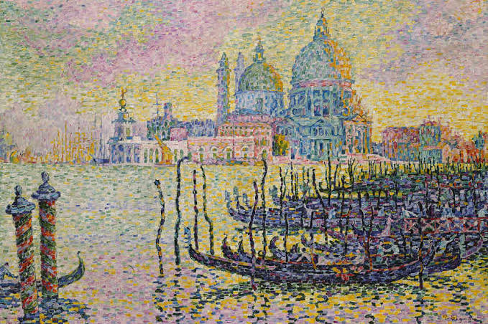
Pointillism

Slide 13
Tempera
Earth or mineral pigments mixed with egg yolk and egg white, gum or glue.
Normally applied on wooden panels.
Advantages
It does not darken or yellow with age.
The oil – egg – milk mixture work as natural emulsion.
Dries quickly; there is blending or fusing of colors.
Disadvantages
Tempera is difficult to spread on very large areas.
It calls for a rigid support. It cannot be freely moved around.

Slide 14
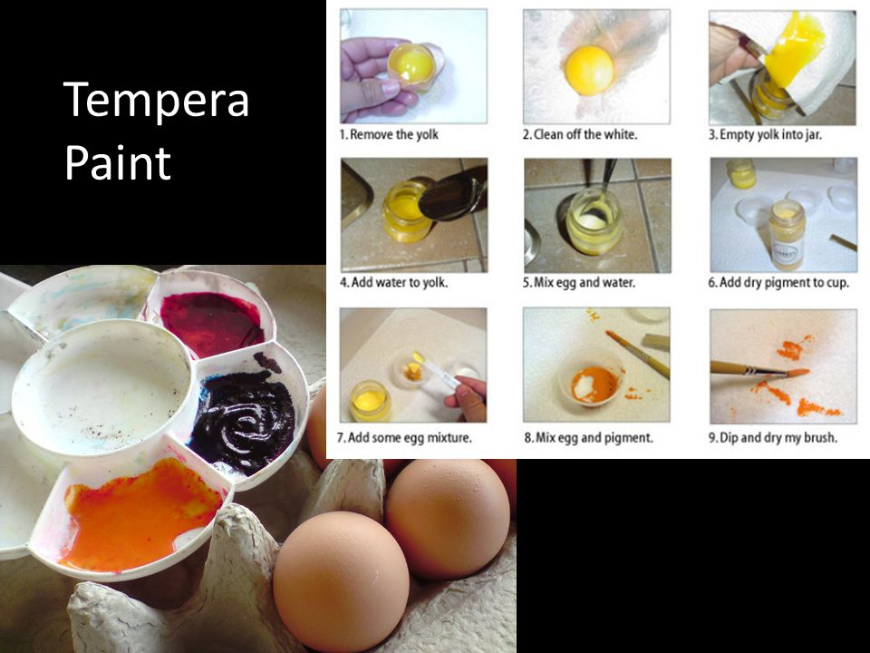

Slide 15
Fresco
Application of Earth pigments mixed with water on a plaster wall while the plaster is damp, color then sinks into the surface and becomes an integral part of the wall.
Fresco is commonly used for mural painting; mural paintings refers to the decoration of walls or ceiling by various techniques.
Advantages
Water is binding agent of fresco.
It is an exacting medium; no possibility of rubbing out.
Disadvantages
It is almost impossible to move a fresco.
Permanently fixed to the wall.

Slide 16
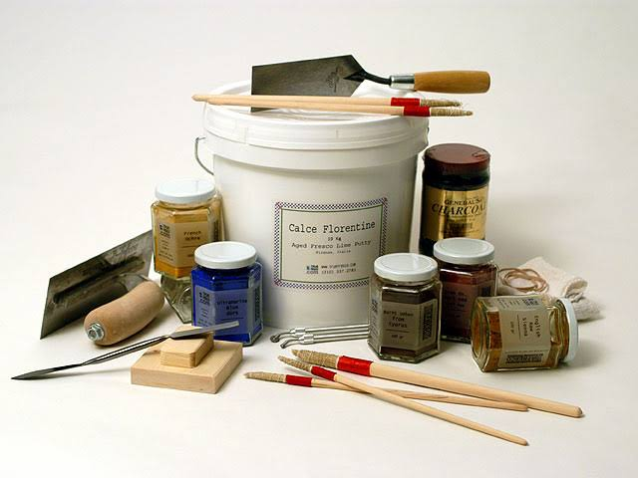
Fresco

Slide 17
DRAWING
Is the most fundamental of all skill needed in the arts.
It maybe a study (made for the sake of learning how to draw some forms); a sketch (showing the general organization or a design of a product being planned); a cartoon (full – size work meant to be a basis for some other work)
Medium of Drawing
Pencil
Lead which comes in different hardness from soft and smudgy to very hard and needle like making possible a wide range of values.

Slide 18
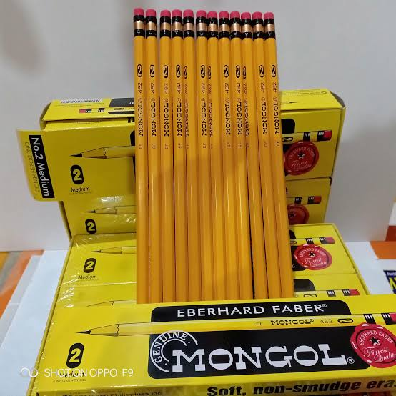
Pencil

Slide 19
Ink
One of the oldest material still in use, allows for a great variety of qualities.
Pen and ink drawings are characterized by precisely controlled and uniformly wide lines.
Pastel
Dry pigment held together with a gum binder and compressed into sticks.
As a finished work of art, these drawings are quite fragile and must be sprayed with a fixative.
Charcoal
Come from a burned twig or piece of wood.

Slide 20
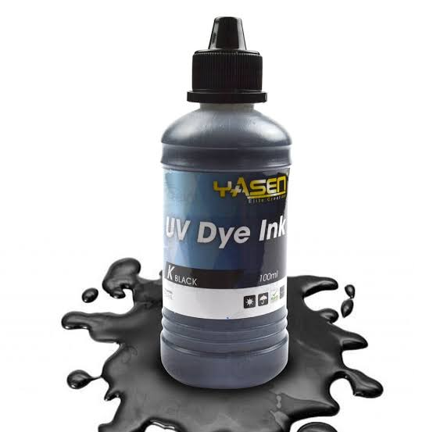
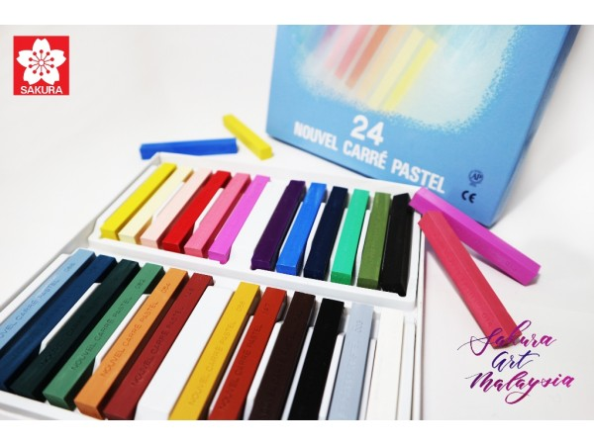
INK
PASTEL

Slide 21
Charcoal
Come from a burned twig or piece of wood.
Modern manufacture charcoal sticks are made from particles of carbon mixed with a binder and compressed.
Softest charcoal produces the darkest most velvety tones and the hardest produces the lightest, grayest ones.
Crayons
Pigment bound by wax and compressed into sticks.

Slide 22
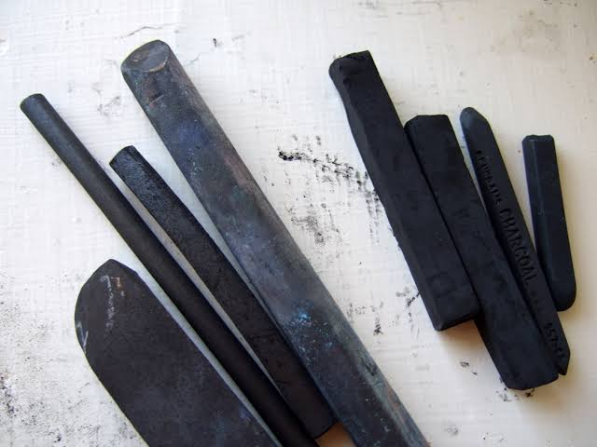
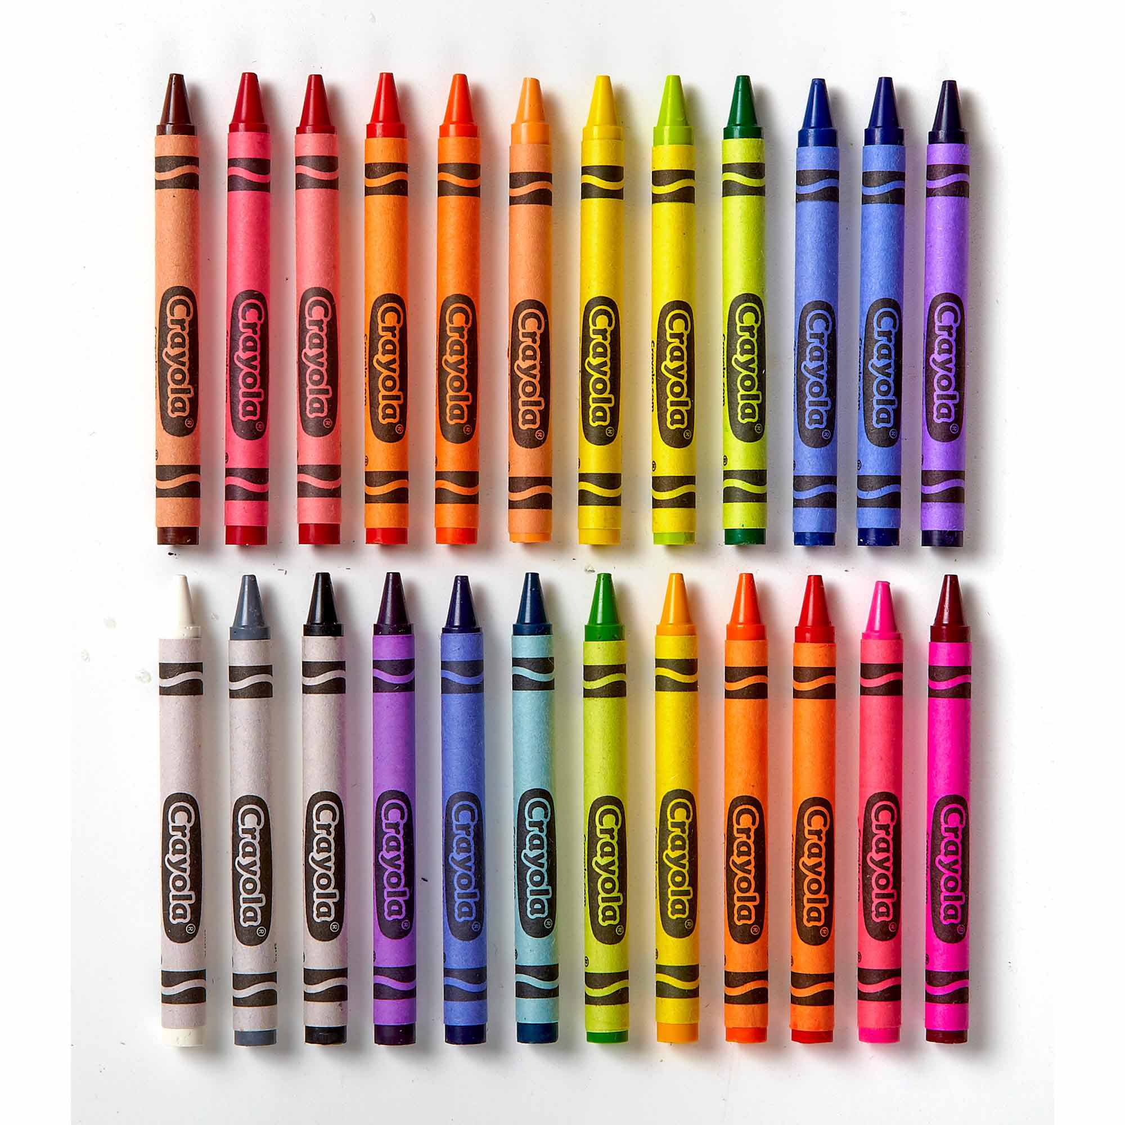
CHARCOAL
CRAYONS

Slide 23
MOSAIC
Are wall and floor decorations made of small cubes or irregularly colored stones called tesserae.
TAPESTRY
These are hangings that added color to the drab interiors and also served to retain in the room whatever heat is generated from the fireplace.
Tapestries are fabrics into which design is woven with colored and metallic threads into a warp that is usually thin; tapestry is originally woven by hand.

Slide 24
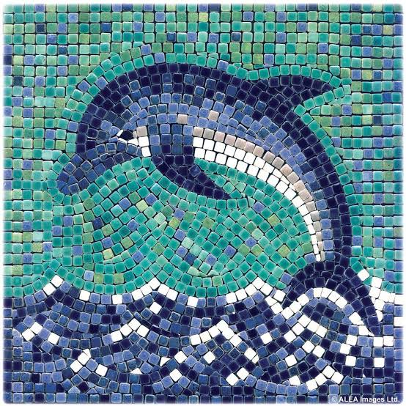
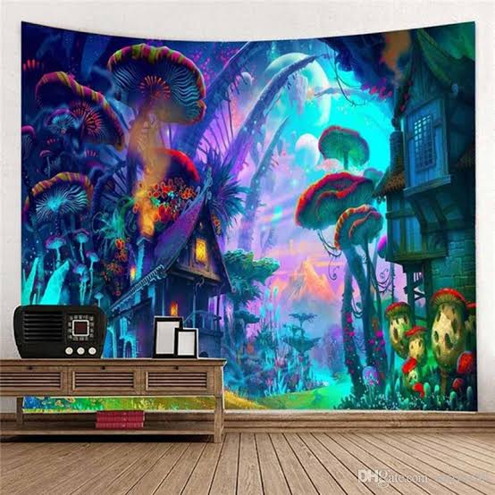
MOSAIC
TAPESTRY

Slide 25
STAINED GLASS
Are the colorful windows that we see in the churches; these follows a pattern and admitted the much needed light in the Romanesque churches.
GRAPHIC PROCESSES (Printmaking)
These are processes for making multi – reproduction of graphic works. All processes involve the preparation of a master image of the drawing or design on some durable materials from which printing is done.

Slide 26
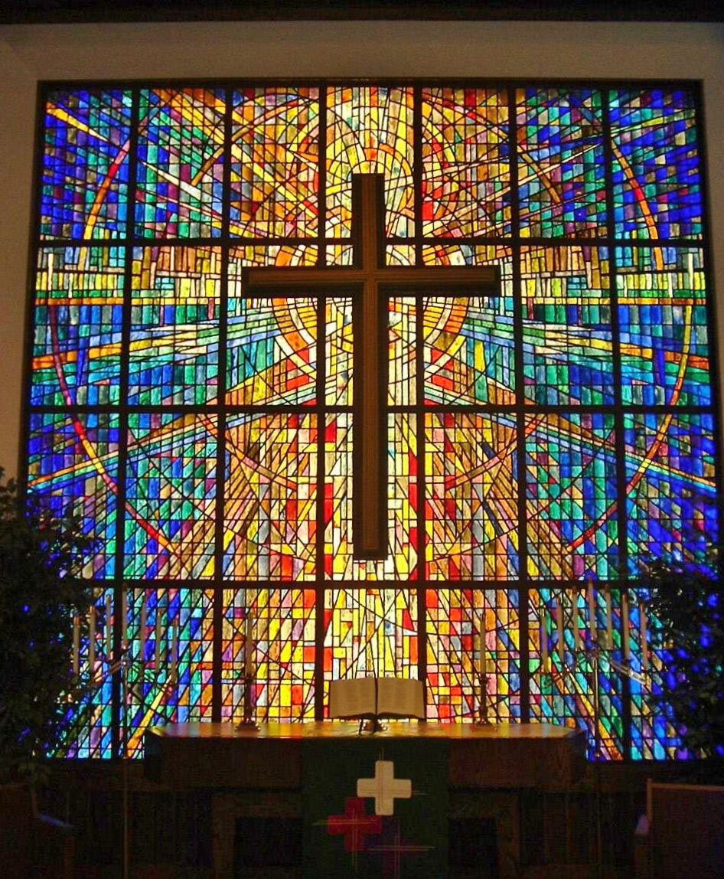
STAINED GLASS

